Slide 1


PARTNER 3
Transcatheter or Surgical Aortic Valve Replacement in Low Risk Patients with Aortic Stenosis
Martin B. Leon, MD &
Michael J. Mack, MD
on behalf of the PARTNER 3 Trial Investigators

Slide 2
Disclosures - Martin B. Leon, MD
ACC 2019; New Orleans, LA; March 16-18, 2019
Within the past 36 months, I or my spouse/partner have had a financial interest/arrangement or affiliation with the organization(s) listed below.
Financial Relationship
Company
Research Support Abbott, Boston Scientific, Edwards Lifesciences, Medtronic
Consulting Fees* Abbott, Boston Scientific, Gore, Medtronic, Meril Life Sciences
Other Edwards Lifesciences**
*Medical or scientific advisory board meetings
** Co-PI PARTNER 3 Trial; travel-related expenses only

Slide 3
Background (1)
Previous PARTNER studies have shown that TAVR was superior to standard therapy in extreme-risk patients and
non-inferior to surgery in high- and intermediate-risk patients.
Over the past decade, technology enhancements and procedural refinements have reduced complications and improved clinical outcomes after TAVR.
The majority of AS patients treated with surgery have low surgical risk profiles and TAVR vs. surgery in such patients has not been investigated in rigorous clinical trials.

Slide 4
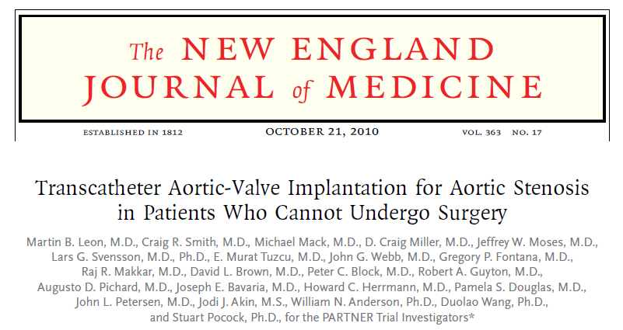
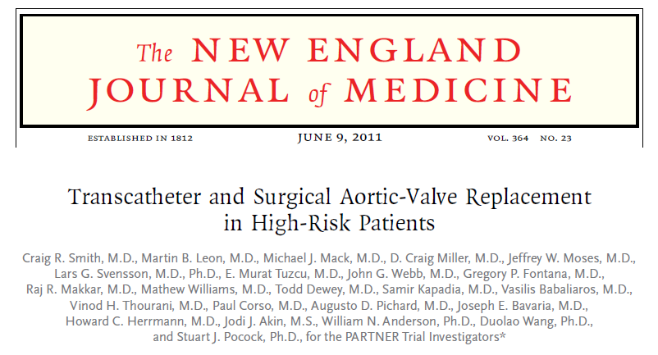
Background (2)
?
PARTNER 3
PARTNER 1B
RCT 1:1
vs. Surgery
N = 1000 pts
RCT 1:1
vs. Standard Rx
N = 358 pts
Low
Risk
Extreme
Risk
Interm
Risk
High
Risk
RCT 1:1
vs. SAVR
N = 2032 pts
RCT 1:1
vs. SAVR
N = 699 pts
PARTNER 2A
PARTNER 1A

Slide 5
Purpose
To compare the safety and effectiveness of the
SAPIEN 3 TAVR system versus conventional surgery in patients with severe symptomatic
aortic stenosis who are at low surgical risk.

Slide 6
PARTNER 3 Study Design
Symptomatic Severe Aortic Stenosis
Low Risk/TF ASSESSMENT by Heart Team
(STS < 4%)
1:1 Randomization
1000 Patients
TAVR
(SAPIEN 3 THV)
Surgery
(Surgical Bioprosthetic Valve)
Follow-up: 30 day, 6 mos, and annually through 10 years
Primary Endpoint:
Composite of all-cause mortality, stroke, or CV re-hospitalization
at 1 year post-procedure
Notes:
No animation

Slide 7
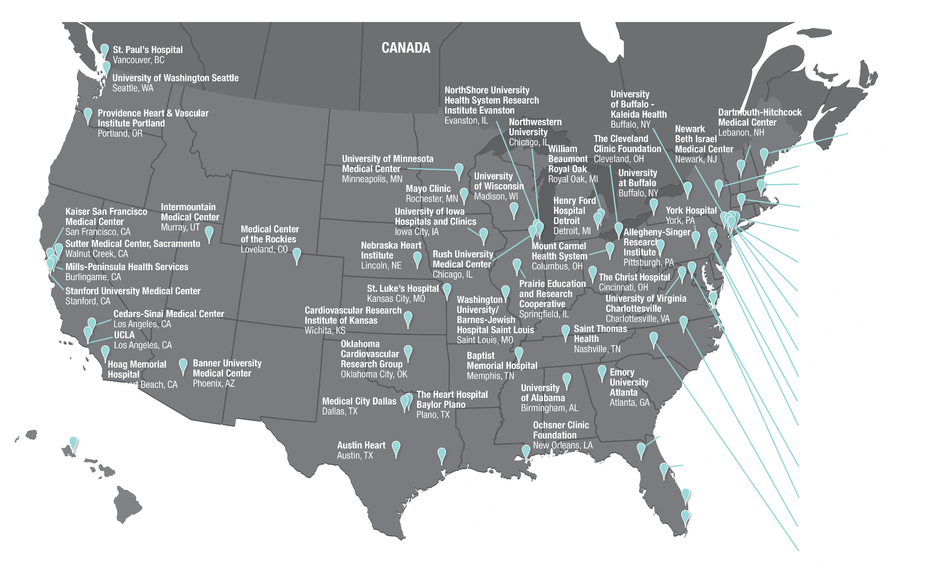







PARTNER 3 Clinical Sites
1 site
3 sites
1 site
1 site
65 sites

Slide 8
Top Enrolling Sites
Heart Hospital Baylor Plano, Plano, TX | David Brown and Michael Mack | 68 pts
Emory University, Atlanta, GA | Vasilis Babaliaros and Robert Guyton | 52 pts
Columbia University Med Ctr, New York, NY | Isaac George, Susheel Kodali, and Tamim Nazif | 41 pts
Cedars-Sinai Med Ctr, Los Angeles, CA | Raj Makkar and Alfredo Trento | 35 pts
Newark Beth Israel Med Ctr, Newark, NJ | Bruce Haik and Mark Russo | 34 pts
NYU Langone Med Ctr, New York, NY | Mathew Williams | 33 pts
Northwestern University, Chicago, IL | Charles Davidson and Chris Malaisrie | 27 pts
University of Washington, Seattle, WA | Gabriel Aldea and James McCabe | 24 pts
Atlantic Health System, Morristown, NJ | John Brown and Robert Kipperman | 23 pts
Banner University Phoenix, Phoenix, AZ | Kenith Fang and Ashish Pershad | 23 pts
Lankenau Med Ctr, Wynnewood, PA | Paul Goady and Scott Goldman | 23 pts
Henry Ford Hospital, Detroit, MI | William O’Neill and Gaetano Paone | 21 pts
Saint Thomas Health, Nashville, TN | Andrew Moore and Evelio Rodriguez | 21 pts
UC Health Rockies, Loveland, CO | Mark Guadagnoli and Brad Oldemeyer | 21 pts
Mills-Peninsula Med Ctr, Burlingame, CA | David Daniels and Conrad Vial | 20 pts
Notes:
8

Slide 9








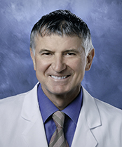
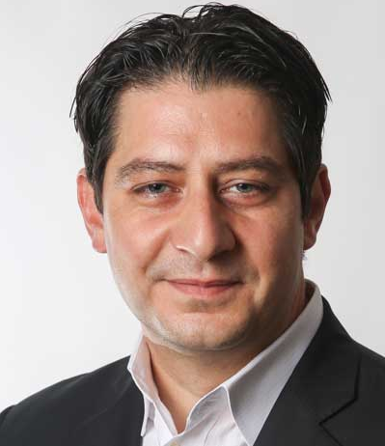

The PARTNER 3 Trial
Top 5 Enrolling Sites
David Brown and Michael Mack
Heart Hospital Baylor Plano; Plano, TX
68 patients enrolled
Robert Guyton and Vasilis Babaliaros
Emory University; Atlanta, GA
52 patients enrolled
Susheel Kodali, Isaac George and Tamim Nazif
Columbia University Med Center; NY, NY
41 patients enrolled
Raj Makkar and Alfredo Trento
Cedars-Sinai Med Center; Los Angeles, CA
35 patients enrolled
Mark Russo and Bruce Haik
Newark Beth Israel Med Center; Newark, NJ
34 patients enrolled

Slide 10
Study Leadership
National Principal Investigators
  Martin B. Leon, MD, Columbia University Medical Center, New York, NY
  Michael J. Mack, MD, The Heart Hospital Baylor Plano, Plano, TX
Steering Committee
  Howard Herrmann, Samir Kapadia, Susheel Kodali, Martin B. Leon, Michael J. Mack,
  Raj Makkar, Craig R. Smith (chair), Wilson Szeto, Vinod Thourani, John Webb
Data & Safety Monitoring Board
  Cardiovascular Research Foundation, New York, NY; Joseph Carrozza, Jr., MD, chair
Clinical Events Committee
  Cardiovascular Research Foundation, New York, NY; Steven O. Marx, MD, chair
CT Core Laboratory
  The University of British Columbia; Jonathon Leipsic, MD, chair; Philipp Blanke, MD, chair
Echocardiographic Core Laboratory
  Quebec Heart & Lung Institute (Laval University); Philippe Pibarot, DVM PhD, chair
  Cardiovascular Research Foundation, New York, NY; Rebecca Hahn, MD, chair
Sponsor
  Edwards Lifesciences, Irvine, CA
Notes:
10

Slide 11
Key Inclusion Criteria
Severe Calcific Aortic Stenosis
  AVA ≤ 1.0 cm² or AVA index ≤ 0.6 cm²/m²
  Jet velocity ≥ 4.0 m/s or mean gradient ≥ 40 mmHg, AND
    NYHA Functional Class ≥ 2, OR
    Abnormal exercise test with severe SOB, abnormal BP response, or arrhythmia, OR
    Asymptomatic with LVEF < 50%
Low Surgical Risk
  Determined by multi-disciplinary heart team
  STS < 4%
  Adjudicated by case review board

Slide 12
Key Exclusion Criteria
Anatomic
  Aortic annulus diameter < 16 mm or > 28 mm (3D imaging)
  Bicuspid valve (CT imaging)
  Severe AR (> 3+) or MR (> 3+)
  Severe LV dysfunction (LVEF < 30%)
  Severe calcification of aortic valvar complex (esp. LVOT)
  Vascular anatomy not suitable for safe femoral access
  Complex CAD: ULM, Syntax score > 32, or not amenable for PCI
  Low coronary takeoff (high risk for obstruction)
Clinical
  Acute MI within 1 month
  Stroke or TIA within 90 days
  Renal insufficiency (eGFR < 30 ml/min) and/or renal replacement Rx
  Hemodynamic or respiratory instability
  Frailty (objective assessment; > 2/4+ metrics)

Slide 13
Study Methodology
      Every patient reviewed (including imaging studies) by multi-disciplinary heart team AND case review board
      Baseline and 30-day neuro assessment in all patients; serial neurologist examinations and neuro-imaging for suspected neuro events
      3D cardiac imaging (CT or TEE) prior to randomization
      Same day or staged concomitant PCI procedures (or surgery
      + CABG) were allowed if approved during case review
      100% CEC adjudication of all major endpoint events (VARC-2 definitions when applicable)
      10-year clinical and echocardiography follow-up in all patients

Slide 14
Primary Endpoint
Non-hierarchical composite of all-cause mortality,
all strokes, or CV re-hospitalization at 1 year
  Primary analysis was non-inferiority, followed by superiority
  Analysis cohort was the ‘as-treated’ (AT) population, defined as all randomized patients in whom the procedure was initiated.
  Multiple sensitivity analyses performed

Slide 15
Sample Size Calculation
      Primary hypothesis: non-inferiority SAPIEN 3 vs. surgery
      for the primary endpoint at 1 year
      Non-inferiority margin: 6% (risk difference)
      One-sided alpha: 0.025
      Assumptions (for 1:1 randomization)
        Event rate: 16.6% for Surgery and 14.6% for TAVR
      Power: 90%
      Sample size: 864 patients (increased to 1,000 patients for
      loss to follow-up, withdrawals and other contingencies)

Slide 16
Statistical Methods
Non-inferiority Testing for Primary Endpoint
  Upper bound of the 95% CI for the risk difference
  (TAVR-surgery) less than the pre-specified non-inferiority margin of 6%
Superiority Testing for Primary Endpoint
  If non-inferiority hypothesis met, superiority testing performed using a 2-sided alpha 0.05
Superiority Testing for Secondary Endpoints
  1) Pre-specified in hierarchical order with multiplicity adjustments and 2) all others (P-values hypothesis generating)

Slide 17
Study Flow and Follow-Up
1520 patients with severe symptomatic AS at low surgical risk
consented between March 25, 2016 and October 26, 2017 at
71 sites in the US, Canada, Japan, ANZ
Excluded from Randomization
N=520
Eligible for Enrollment
and Randomized
N=1000 at 71 sites
Anatomic exclusions (n=308)
Clinical exclusions (n=89)
Other exclusions (n=38)
Incomplete screening (n=85)
TAVR
N=503
Surgery
N=497

Slide 18
Study Populations
ITT to AT Patient Cohorts
Randomized
N=1000
TAVR (ITT)
N = 503
Surgery (ITT)
N = 497
0% (0)
0.2% (1)
1.2% (6)
1.4% (7)
Died before treatment
Exclusions after randomization
Withdrawal
Total
0% (0)
1.6% (8)
7.0% (35)
8.7% (43)
Procedure Initiated (AT)
N = 496
Procedure Initiated (AT)
N = 454

Slide 19
Patient Disposition
As Treated Population
N=950
TAVR Initiated (AT) N = 496
Surgery Initiated (AT) N = 454
1 Conversion to surgery
1 Aborted procedure
Valve Implanted (VI)
N = 495
Valve Implanted (VI)
N = 453
4 Withdrawals
TAVR with complete 30-day
follow up for primary endpoint
N = 496/496
(100%)
Surgery with complete 30 day follow-up for primary endpoint
N = 450/454
(99.1%)
1 Withdrawal
2 Missed visits
11 Withdrawals
1 Lost to follow-up
TAVR with complete 1 year
follow-up for primary endpoint
N = 493/496
(99.4%)
Surgery with complete 1 year follow-up for primary endpoint
N = 442*/454
(97.4%)
98.4% Follow-up for Primary Endpoint
*4 patients who withdrew from the surgery arm are considered to have complete 1-yr follow-up b/c they had already experienced an endpoint event prior to withdrawing from the study.

Slide 20
Baseline Patient Characteristics
% or mean ± SD
Demographics & Vascular Disease | TAVR (N=496) | Surgery (N=454) | Other Co-Morbidities | TAVR (N=496) | Surgery (N=454)
Age (years) | 73.3 ± 5.8 | 73.6 ± 6.1 | Diabetes | 31.3% | 30.2%
Male | 67.5% | 71.1% | COPD (any) | 5.1% | 6.2%
BMI – kg/m² | 30.7 ± 5.5 | 30.3 ± 5.1 | Pulmonary Hypertension | 4.6% | 5.3%
STS Score | 1.9 ± 0.7 | 1.9 ± 0.6 | Creatinine > 2mg/dL | 0.2% | 0.2%
NYHA Class III or IV* | 31.3% | 23.8% | Frailty (overall; > 2/4+) | 0 | 0
Coronary Disease | 27.7% | 28.0% | Atrial Fibrillation (h/o) | 15.7% | 18.8%
Prior CABG | 3.0% | 1.8% | Permanent Pacemaker | 2.4% | 2.9%
Prior CVA | 3.4% | 5.1% | Left Bundle Branch Block | 3.0% | 3.3%
Peripheral Vascular Disease | 6.9% | 7.3% | Right Bundle Branch Block | 10.3% | 13.7%
*p = 0.01

Slide 21
Baseline Echo and CT Characteristics
% or mean ± SD
Characteristic | TAVR (N=496) | Surgery (N=454)
Aortic Valve Area (cm²) | 0.8 ± 0.2 | 0.8 ± 0.2
Mean Gradient (mmHg) | 49.4 ± 12.8 | 48.3 ± 11.8
LVEF (%) | 65.7 ± 9.0 | 66.2 ± 8.6
LV Mass Index (g/m²) | 104.5 ± 25.7 | 101.5 ± 25.4
≥ Moderate MR | 1.3% | 3.2%
≥ Moderate AR | 3.9% | 2.5%
≥ Moderate TR | 1.7% | 2.3%
CT – Annulus Perimeter (mm) | 78.1 ± 6.9 | 78.6 ± 7.2
CT – Annulus Area (mm²) | 473.5 ± 83.3 | 479.6 ± 87.6

Slide 22
Procedural & Hospital Findings
% or mean ± SD
Variable | TAVR (N=496) | Surgery (N=454) | P-value
Conscious Sedation | 65.1% | NA | NA
Procedure Time (min) | 58.6 ± 36.5 | 208.3 ± 62.2 | <0.001
Fluoroscopy Time (min) | 13.9 ± 7.1 | NA | NA
Aortic Cross-Clamp Time (min) | NA | 74.3 ± 27.8 | NA
Total CPB Time (min) | NA | 97.7 ± 33.8 | NA
Median ICU Stay (days) | 2.0 | 3.0 | <0.001
Median Total LOS (days) | 3.0 | 7.0 | <0.001
Discharge to Home/Self-care | 96.0% | 73.1% | <0.001
Concomitant Procedures | 7.9% | 26.4% | <0.001

Slide 23
Procedural Complications
In-Hospital
% or mean ± SD
Complication | TAVR (N=496) | Surgery (N=454) | P-value
In-hospital Death | 0.4% (2) | 0.9% (4) | 0.43
> 2 Transcatheter Valves Implanted* | 0.2% (1) | NA | NA
Valve Embolization | 0 | NA | NA
Aortic Dissection | 0 | NA | NA
Annular Rupture | 0.2% (1) | NA | NA
Ventricular Perforation | 0.2% (1) | 0.4% (2) | 0.61
Coronary Obstruction | 0.2% (1) | 0.4% (2) | 0.61
Access Site Infections | 0.4% (2) | 1.3% (6) | 0.16
*Valve-in-valve

Slide 24
Primary Endpoint
20
Upper 95% CI of
risk diff = -2.5%
Surgery
TAVR
P_{non-inferiority}< 0.001
15.1%
9.3%
10
8.5%
Death, Stroke, or Rehosp (%)
HR [95% CI] =
0.54 [0.37, 0.79]
4.2%
P_{superiority}= 0.001
0
0
3
6
9
12
Months after Procedure
Number at risk:
Surgery
454
408
390
381
377
374
TAVR
496
475
467
462
456
451

Slide 25
All-Cause Mortality
20
Surgery
HR [95% CI] = 0.41 [0.14, 1.17]
TAVR
P = 0.09
10
All-Cause Mortality (%)
1.1%
2.5%
1.0%
0
0
0.4%
3
6
9
12
Months from Procedure
Number at risk:
Surgery
454
445
438
433
431
427
TAVR
496
494
494
493
492
488

Slide 26
All Stroke
20
Surgery
HR [95% CI] = 0.38 [0.15, 1.00]
TAVR
P = 0.04
10
All Stroke (%)
2.4%
3.1%
1.2%
0
0
0.6%
3
6
9
12
Months from Procedure
Number at risk:
Surgery
454
435
427
423
421
417
TAVR
496
491
491
489
487
484

Slide 27
Death or Disabling Stroke
20
Surgery
HR [95% CI] = 0.34 [0.12, 0.97]
TAVR
P = 0.03
10
Death or Disabling Stroke (%)
1.3%
2.9%
1.0%
0
0
0.4%
3
6
9
12
Months from Procedure
Number at risk:
Surgery
454
444
436
432
430
426
TAVR
496
494
494
493
491
488

Slide 28
Rehospitalization
20
Surgery
HR [95% CI] = 0.65 [0.42, 1.00]
TAVR
P = 0.046
11.0%
10
Rehospitalization (%)
6.5%
7.3%
3.4%
0
0
3
6
9
12
Months from Procedure
Number at risk:
Surgery
454
416
399
389
385
382
TAVR
496
477
469
465
459
453

Slide 29
Primary Endpoint Sensitivity Analyses
Intention-to-Treat Population
20
Surgery
TAVR
14.8%
8.8%
10
8.4%
Death, Stroke, or Rehosp (%)
4.2%
HR [95% CI] = 0.55 [0.37, 0.80]
P = 0.002
0
0
3
6
9
12
Months after Procedure
Number at risk:
Surgery
497
420
395
382
378
374
TAVR
503
478
469
462
456
451

Slide 30
Primary Endpoint Sensitivity Analyses
Multiple Imputation
 | TAVR (N=503) | Surgery (N=497) | KM Rate Difference (TAVR – Surgery) | 95% CI* for the Difference | P-value (non-inf) | HR | 95% CI for the HR | P-value (sup)
Missing at Random | 8.5% | 15.2% | -6.7% | (-10.7%, -2.7%) | Pass <0.001 | 0.53 | (0.37, 0.78) | <0.001
Informative Missing | 8.6% | 15.2% | -6.6% | (-10.6%, -2.6%) | Pass <0.001 | 0.54 | (0.37, 0.78) | <0.001
*95% CI based on the Greenwood standard error
WIN Ratio
Item | Value | P-value
Total no. of pairs | 454 X 496 = 225,184
Win ratio for composite (total wins in TAVR / total wins in Surgery) | 1.88 | 0.001
95% CI* | [1.29, 2.76]
*95% CI and p-value is based on the Finkelstein and Schoenfeld approach

Slide 31
Primary Endpoint - Subgroup Analysis
Subgroup | TAVR | Surgery |  | Diff [95% CI] | P-value*
Overall | 8.5 | 15.1 |  | -6.6 [-10.8, -2.5]
Age ≤ 74 (n=516) > 74 (n=434) | 10.6 5.8 | 14.9 15.3 |  | -4.3 [-10.1, 1.5] -9.5 [-15.3, -3.7] | 0.21
Sex Female (n=292) Male (n=658) | 8.1 8.7 | 18.5 13.8 |  | -10.4 [-18.3, -2.5] -5.1 [-9.9, -0.3] | 0.27
STS Score ≤ 1.8 (n=464) > 1.8 (n=486) | 9.1 8.0 | 15.7 14.5 |  | -6.7 [-12.6, -0.7] -6.5 [-12.2, -0.8] | 0.98
LV Ejection Fraction ≤ 65 (n=384) > 65 (n=524) | 9.6 8.0 | 17.2 12.4 |  | -7.6 [-14.5, -0.7] -4.4 [-9.6, 0.7] | 0.48
NYHA Class I/II (n=687) III/IV (n=263) | 6.8 12.3 | 14.5 16.9 |  | -7.8 [-12.4, -3.2] -4.7 [-13.5, 4.1] | 0.54
Atrial Fibrillation No (n=786) Yes (n=163) | 7.9 11.6 | 14.0 20.3 |  | -6.1 [-10.5, -1.7] -8.7 [-19.9, 2.5] | 0.67
KCCQ Overall Summary Score ≤ 70 (n=407) > 70 (n=536) | 10.5 6.5 | 19.9 11.2 |  | -9.4 [-16.5, -2.4] -4.6 [-9.4, 0.2] | 0.27
Event rates are KM estimates (%)
-20%
-10%
0
10%
20%
* P-value is for interaction
← TAVR Better Surgery Better →

Slide 32
Pre-specified Secondary Endpoints
Subject to Multiplicity Adjustment
Order of Testing | Endpoint | TAVR (N=496) | Surgery (N=454) | Treatment Effect [95% CI] | P-value
1 | New onset atrial fibrillation at 30 days | 5.0% | 39.5% | 0.10 [0.06, 0.16]
2 | Length of index hospitalization (days) | 3.0 (2.0, 3.0) | 7.0 (6.0, 8.0) | -4.0 [-4.0, -3.0]
3 | All-cause death, all stroke, or rehospitalizations at 1 year | 8.5% | 15.1% | 0.54 [0.37, 0.79]
4 | Death, KCCQ < 45 or KCCQ decrease from baseline ≥ 10 points at 30 days | 3.9% | 30.6% | -26.7% [-31.4%, -22.1%]
5 | Death or all stroke at 30 days | 1.0% | 3.3% | 0.30 [0.11, 0.83]
6 | All stroke at 30 days | 0.6% | 2.4% | 0.25 [0.07, 0.88]
* P-value is Log-Rank test for items 1, 3, 5 and 6; P-value is Wilcoxon Rank-Sum Test for item 2; P-value is Fisher’s Exact test for item 4

Slide 33
Pre-specified Secondary Endpoints
Subject to Multiplicity Adjustment
Order of Testing | Endpoint | TAVR (N=496) | Surgery (N=454) | Treatment Effect [95% CI] | P-value
1 | New onset atrial fibrillation at 30 days | 5.0% | 39.5% | 0.10 [0.06, 0.16] | <0.001
2 | Length of index hospitalization (days) | 3.0 (2.0, 3.0) | 7.0 (6.0, 8.0) | -4.0 [-4.0, -3.0] | <0.001
3 | All-cause death, all stroke, or rehospitalizations at 1 year | 8.5% | 15.1% | 0.54 [0.37, 0.79] | 0.001
4 | Death, KCCQ < 45 or KCCQ decrease from baseline ≥ 10 points at 30 days | 3.9% | 30.6% | -26.7% [-31.4%, -22.1%] | <0.001
5 | Death or all stroke at 30 days | 1.0% | 3.3% | 0.30 [0.11, 0.83] | 0.01
6 | All stroke at 30 days | 0.6% | 2.4% | 0.25 [0.07, 0.88] | 0.02
* P-value is Log-Rank test for items 1, 3, 5 and 6; P-value is Wilcoxon Rank-Sum Test for item 2; P-value is Fisher’s Exact test for item 4

Slide 34
Other Secondary Endpoints
Outcomes | 30 Days |  |  | 1 Year
 | TAVR (N=496) | Surgery (N=454) | P-value | TAVR (N=496) | Surgery (N=454) | P-value
Bleeding - Life-threat/Major | 3.6% (18) | 24.5% (111) | <0.001 | 7.7% (38) | 25.9% (117) | <0.001
Major Vascular Complics | 2.2% (11) | 1.5% (7) | 0.45 | 2.8% (14) | 1.5% (7) | 0.19
AKI - stage 2 or 3* | 0.4% (2) | 1.8% (8) | 0.05 | 0.4% (2) | 1.8% (8) | 0.05
New PPM (incl baseline) | 6.5% (32) | 4.0% (18) | 0.09 | 7.3% (36) | 5.4% (24) | 0.21
New LBBB | 22.0% (106) | 8.0% (35) | <0.001 | 23.7% (114) | 8.0% (35) | <0.001
Coronary Obstruction | 0.2% (1) | 0.7% (3) | 0.28 | 0.2% (1) | 0.7% (3) | 0.28
AV Re-intervention | 0% (0) | 0% (0) | NA | 0.6% (3) | 0.5% (2) | 0.76
Endocarditis | 0% (0) | 0.2% (1) | 0.29 | 0.2% (1) | 0.5% (2) | 0.49
Asymp Valve Thrombosis | 0.2% (1) | 0% (0) | 0.34 | 1.0% (5) | 0.2% (1) | 0.13
Event rates are KM estimates (%) and p-values are based on Log-Rank test
* Event rates are incidence rates and p-value is Fisher’s Exact test

Slide 35
Echocardiography Findings
Mean Gradient
49.4
Surgery
48.3
TAVR
Mean Gradient (mmHg)
P < 0.001
P < 0.001
12.8
13.7
11.2
11.6
Baseline
30D
1 Year
No. of Echos
Surgery
TAVR
441
426
390
483
490
469
P-values are based on the ANCOVA for TAVR vs Surgery adjusted by baseline.

Slide 36
Echocardiography Findings
Aortic Valve Area
1.8
1.8
1.7
1.7
P = 0.04
P = 0.05
0.8
Valve Area (cm²)
0.8
Surgery
TAVR
Baseline
30D
1 Year
No. of Echos
Surgery
TAVR
423
395
371
458
470
446
P-values are based on the ANCOVA for TAVR vs Surgery adjusted by baseline.

Slide 37
The PARTNER Trials
Valve Size Distribution
29mm
26mm
23mm
20mm
0.5
0.9
29mm
27mm
25mm
23mm
21mm
% of Patients
% of Patients
19mm
17mm
3.9
2.2
0.1

Slide 38
Paravalvular Regurgitation
≥ mod PVR: P = 0.13
≥ mod PVR: P = 1.00
0.8
0
0.6
0.5
≥ Moderate
Mild
None/Trace
Percentage of Patients
30 Days
1 Year
P-values are based on the Wilcoxon rank-sum test.

Slide 39
Paravalvular Regurgitation
mild PVR: P < 0.001
mild PVR: P < 0.001
0.8
0
0.6
0.5
≥ Moderate
Mild
None/Trace
Percentage of Patients
30 Days
1 Year
P-values are based on the Wilcoxon rank-sum test.

Slide 40
Functional Assessments
NYHA
Class II/III/IV
Six-Minute
Walk Distance
KCCQ Overall
Summary Score
TAVR
Surgery
TAVR
Surgery
TAVR
Surgery
P < 0.01
P = 0.19
P < 0.01
P = 0.76
P < 0.01
P = 0.94
Percentage of Patients (%)
Percentage Change from Baseline (%)
30 Days
1 Year
30 Days
1 Year
30 Days
1 Year
P-values are based on Fisher’s Exact test.
P-values are based on the ANCOVA for TAVR vs Surgery adjusted by baseline.

Slide 41
The PARTNER 3 Trial
Study Limitations
Results only reflect 1-year outcomes; long-term assessment of structural valve deterioration is required
  10-year clinical and echocardiographic FU planned in all patients
Results only apply to the enrolled AS population
(e.g. bicuspid aortic valves, non-suitable for TF, and complex CAD excluded)

Slide 42
The PARTNER 3 Trial
Conclusions (1)
In a population of severe symptomatic aortic stenosis patients who were at low surgical risk, TAVR (using the SAPIEN 3 valve) compared to surgery:
Significantly reduced the primary endpoint of death, stroke, or rehospitalization by 46% at 1-year.
  Components of the primary endpoint favored TAVR, both at
  30 days and 1 year
  Multiple sensitivity analyses confirmed robustness of the primary endpoint findings

Slide 43
The PARTNER 3 Trial
Conclusions (2)
Secondary endpoints adjusted for multiple comparisons indicated that TAVR reduced new-onset AF, index hospitalization days, and a measure of poor treatment outcome (death or low KCCQ score at 30 days).
Other secondary endpoint analyses also showed reduced bleeding after TAVR and no differences in the need for new permanent pacemakers, major vascular complications, coronary obstruction, and mod-severe PVR.
Some secondary endpoints favored surgery, including reduced new LBBB, reduced mild PVR, and lower aortic valve gradients.

Slide 44
The PARTNER 3 Trial
Conclusions (3)
TAVR had more rapid post-procedure improvement in
patient-oriented functional indices, including NYHA class,
6-minute walking distance, and KCCQ scores.

Slide 45
The PARTNER 3 Trial
Clinical Implications
Based upon these findings, TAVR, through 1-year, should be considered the preferred therapy in low surgical risk aortic stenosis patients!
PARTNER randomized trials over the past 12 years, clearly indicate that the relative value of TAVR compared with surgery
is independent of surgical risk profiles.
The choice of TAVR vs. surgery in aortic stenosis patients should be a shared-decision making process, respecting patient preferences, understanding knowledge gaps (esp. in younger patients), and considering clinical and anatomic factors.

Slide 46
The PARTNER 3 Trial
PARTNER 3
PARTNER 1B
RCT 1:1
vs. Surgery
N = 1000 pts
RCT 1:1
vs. Standard Rx
N = 358 pts
Low
Risk
Extreme
Risk
Interm
Risk
High
Risk
RCT 1:1
vs. SAVR
N = 2032 pts
RCT 1:1
vs. SAVR
N = 699 pts
PARTNER 2A
PARTNER 1A

